Slide 1
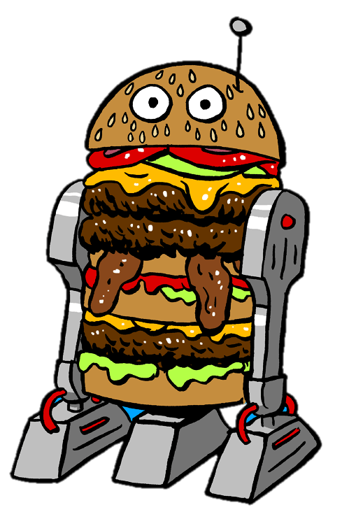

Next GEN interface For FOOD Ordering

Slide 2
Problem statement
Order to Delivery aka (order-to-cash process) is an extremely important business process in manufacturing , retail and services industry.
It is a customer facing process and is key to operational efficiencies and customer satisfaction.
The proposed solution will address –
Can the order creating process create differentiation and competitive advantage ?
Can the use of technology bring the transformation and make user online ordering experience efficient and interactive ?

Slide 3
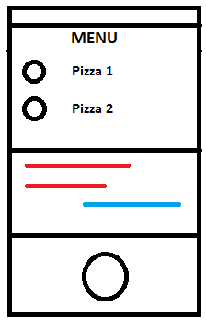



Overview of foodbot
USER UTTERANCE
WEBSITE
BOT ENGINE
(UX/UI)
(NLP)
REPLY FROM BOT
A
B
FINALIZED ORDER
MONGO DB
PRINT RECEIPT
STORAGE
THERMAL PRINTER
(via Bluetooth)
C
D

Slide 4
Working Explained ….
Web Portal (user Front end)
Dynamic and easy to use UI (website) through which user can interact with bot seamlessly using his/her voice interaction.
Intuitive UI using – Bootstrap, JQuery, HTML5 , CSS3 , Google Speech APIs
Bot Engine
A BOT , is an intelligent virtual assistant, trained to perform specific task will converse with user based on the user intent.
A BOT is open source platform build in-house using state-of-the-art cognitive technology. It is able to respond to user requests and can perform actions based on them.

Slide 5
Working Explained ….
Order Management
For processing and tracking order in real-time data, we need an efficient order management system.
NoSQL-unstructured databases MongoDB will be used to store data in the form of 'documents', which is essentially JSON.
User , Menu and order schema will help in managing users , food items and orders.
Delivery Management
To complete Order-to-Delivery cycle , we will be using a Bluetooth thermal printer for printing receipts. (both for end user as well as for Kitchen)
The acknowledgement as well as a copy of receipt will be sent to user on his registered mail-id
Complete human-less experience – no waitstaff, no cashier, no one to get your order wrong and no one to tip.

Slide 6
Focus Areas
DIGITAL TRANSFORMATION :
Use of intelligent BOT to automate services and workflows for customers improving productivity and operational efficiency.
USER EXPERIENCE :
Highly intuitive user experience to provide personalized and natural way of interaction with the system.
TECHNOLOGY AND INNOVATION :
State-of-the-art cognitive technology. Use of Speech Recognition ,ML and Sensor Fusion is used as part of technological innovation.
EXECUTION :
Entire project is divided into 4 modules as shown in overview .There is dedicated team of 2 for each module. Agile methodology is followed for this project which should help in achieving the goal with in 24 hours of development.

Slide 7
WINNING Team
UI/UX
Deeksha
Payal
BOT Engine
Uzma
Swapnil
Order Management
Tejas
Pooja
Delivery Management
Harsh
Varun
Team Owner
Dr. Sid
Purushottam
. Mentor
Praful
Rohit

Slide 8
Thank you

